Slide 1

Wireless Networking: history, pros and cons, and security
Janelle Gregg
For CET 751:Computer Hardware and Networking Essentials
Professor Tom Farrell

Slide 2
History:
Opening of Radio Waves:
1985: FCC opens several bands of radio waves for communication, free from government licensing.
Known as the “garbage bands,” they were already used by other equipment.
Allowed for “spread spectrum” = use of multiple frequencies, to avoid interference and interception.
Wireless Devices:
1988: a committee was formed to write a standard so the wireless devices from different vendors would be compatible.

Slide 3

History:
Wireless Devices cont.
1997: agreement was reached on the new standard.
1999: six companies formed WECA. The group would certify that devices were compatible to the new standard.
WLANs:
1990: the standard was approved for wireless networking.
Since then, wireless networks have surpassed growth expectations.
Found just about everywhere: ball parks, coffee shops, airports, airplanes malls, even city wide.

Slide 4
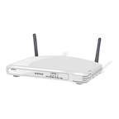
Pros:
Convenience: connections to a network can be almost anywhere.
Mobility: work can continue across locations as people move within the network.
Productivity: Work can be done in collaboration groups not just at an employees desk.
Cost effective: no or little wiring costs make set up costs minimal.
Reliability: No cracked or corroded cables. Recovery time is shortened after events like natural disasters.

Slide 5
Cons:
Interference: shared radio frequencies can mean that wireless devices interfere with the workings of other equipment on the same frequencies. Also, the equipment can cause interference between the device and the network.
Bandwidth: all devices on a network share the bandwidth of the network. The more devices on a network, the more the bandwidth is shared. One device transmitting large files can use the majority of the bandwidth of a network.
Health Implications: Though no studies have declared this to be true, neither can they deny their could be a problem. Radio waves in high levels are known to cause biological damage.

Slide 6

Security:
Always changing and adapting to keep up with attacks.
Data encryption: keeps attackers from being able to read intercepted data.
WEP: used 64 or 128 bit numbers to encrypt data. A 24 bit initialization vector was short and easy to break.
WPA: it uses a TKIP, 128 bit key that regenerates with each packet. MIC, prevents attackers from capturing, altering, or resending packets. PSK, users enter a code to access the network.
WPA2: second generation based on Advanced Encryption Standard.

Slide 7

Security:
Access and Authentication:
MAC addresses allow identification for access to the network.
Once identified by the network, authentication passwords are an added security feature.
SSID: AP and STA send and receive a matched SSID to authenticate and allow access.

Slide 8
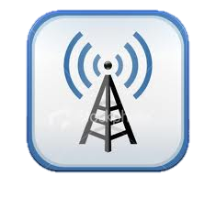
Security Basics:
Change the default SSID.
Configure the AP correctly.
Segment the wireless network.
Use a firewall, packet filter, or similar device between the AP and intranet.
Do not openly broadcast the SSID.
Use current anti-virus software.
Strategically place APs within secure perimeter.
Use Rogue AP Discovery tools
Set up VLANs separate for employees and guests.

Slide 9
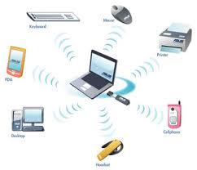
Attacks:
Security needs to constantly avance to fight attacks.
Wardriving: Using a computer, NIC, and GPS to detect hotspots and post for others to attack
Fake anti-virus attacks
Attacks against online banking
Phone solicitation to get personal data
Email attacks
USB transfer of viruses
Malware
All these attacks are then spread easily to other devices on a wireless network.

Slide 10
Wireless Networking Tips
Understand the basics of the system.
Way the pros and cons.
Know the different ways to secure your system.
Be aware that people are constantly trying to attack systems.
Enjoy your wireless devices and convenience of wireless networking.

